Slide 1
Autosomal DNA

Slide 2



A
WFGS
Presentation

Slide 3
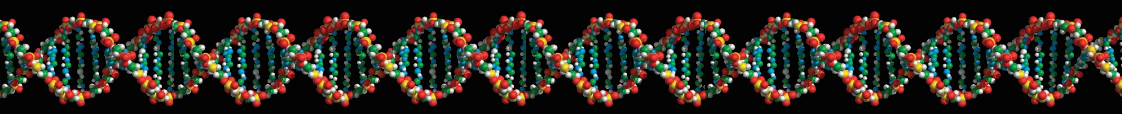
Autosomal DNA
23andMe
by
Jerry Merritt

Slide 4

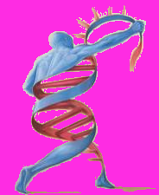
Objectives
Explain the challenges of Autosomal DNA tests.
Provide a tour of a 23andMe autosomal account.
Show how to deal with the chaos.

Slide 5
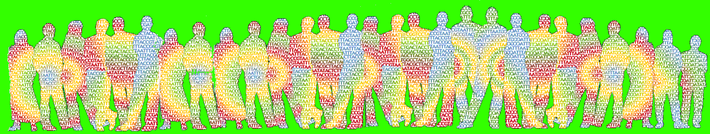
There are now three different DNA tests available to gather information about one's ancestry
Y-chromosome or Y-DNA (paternal line)
Mitochondrial or mtDNA (maternal line)
Autosomal DNA (all lines)

Slide 6
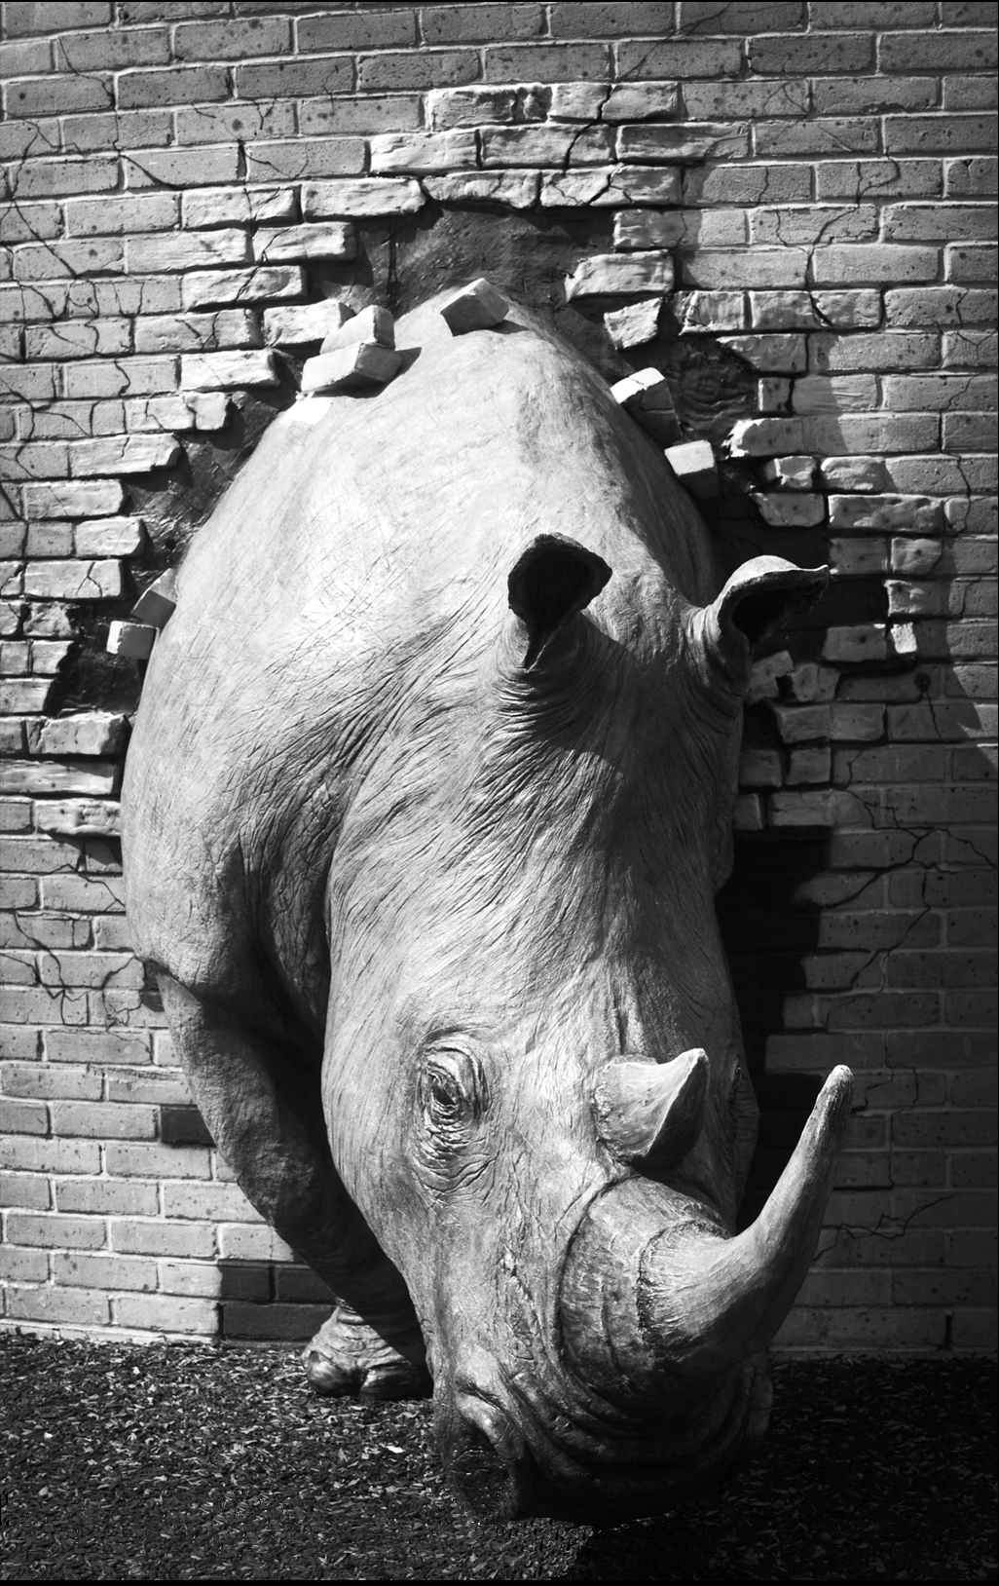

DNA is not a Shortcut
DNA testing, autosomal included, is not a shortcut around doing your research.
DNA testing, alone, can’t tell you who your missing ancestor is.
DNA testing’s primary use is to identify others who share identical or near identical segments of your DNA so you can perhaps figure out which ancestor gave you each the shared segment.
Then you hope one of them already solved the problem you are working on.

Slide 7
Y-chromosome
The Y chromosome is only found in males.
It is passed only from father to son.
A large section of the Y chromosome does not undergo recombination during meiosis….
…making it ideal for tracking patrilineage.

Slide 8


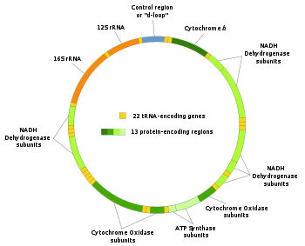
Mitochondrial DNA
Mitochondria are cellular organelles that provide energy for various cellular functions.
mtDNA is a circular molecule.
Every human cell contains between 100 and 10,000 copies of mitochondrial DNA

Slide 9
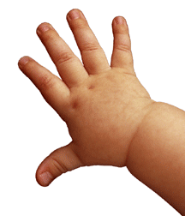


mtDNA is passed only from mother to child.
Like the Y chromosome, mitochondrial DNA does not recombine and thus there is no change between parent and child.
Although males inherit mtDNA from their mothers, they do not pass it on to their children.
This allows mtDNA to be used for tracing matrilineage.

Slide 10
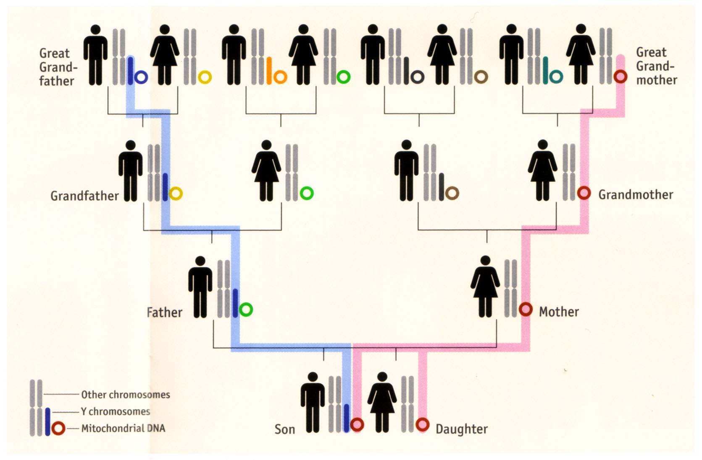
Y & mtDNA Inheritance

Slide 11
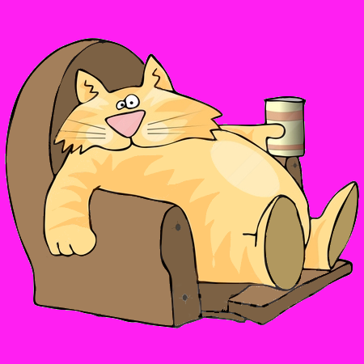

STRs, SNPs & Haplogroups
The Y and mtDNA contain two types of ancestral markers.
short tandem repeats, aka microsatellites.
STRs appear to be useless.
But are nice to have around if you’re a genealogist.
STRs

Slide 12
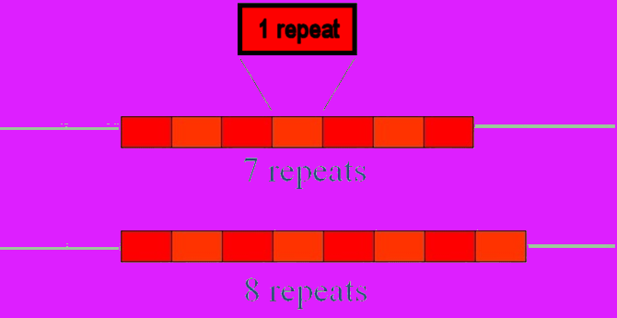
Short Tandem Repeats
STRs change by the number of repeats of base pairs and change at a much faster rate than SNPs.
The rate of change is fast enough that you can estimate how many generations back you share a most recent common ancestor with another person with a similar match to you.
ATG
ATG
ATG
ATG
ATG
ATG
ATG

Slide 13
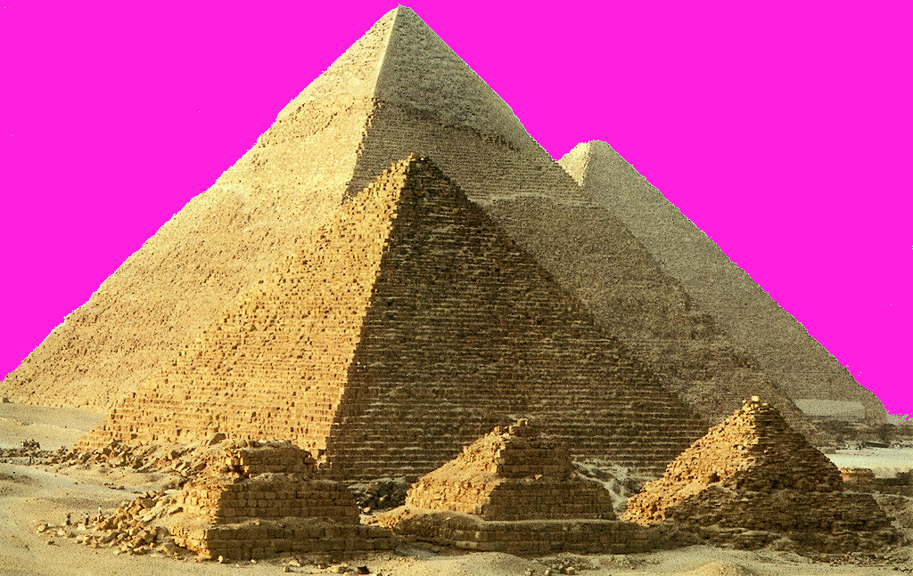
Single Nucleotide Polymorphisms
SNPs
Will outlast the Pyramids

Slide 14
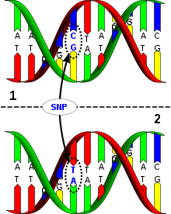
SNP on DNA

Slide 15

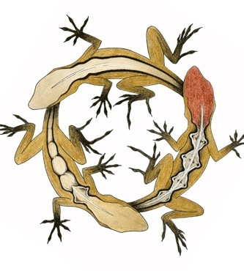
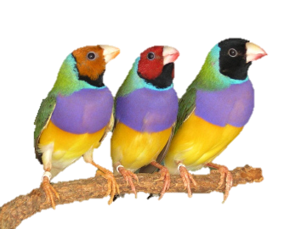

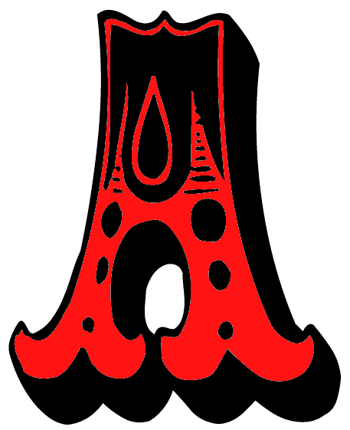

SNPs
SNPs are a change in a single nucleotide in the DNA and occur infrequently; however, once they occur they are stable and typically define a whole chromosome and become its signature.

Slide 16
STRs, SNPs & Haplogroups
SNPs allow you to track ancient ancestry….
…while STRs allow you to track recent ancestry in the range of immediate family history over several generations.

Slide 17
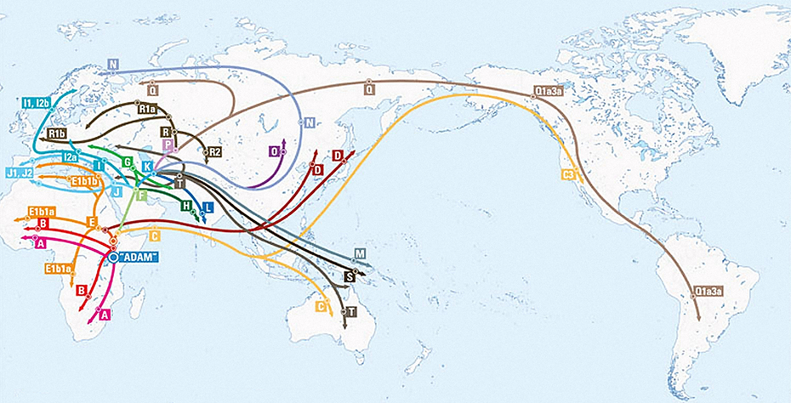
Y Haplogroups

Slide 18
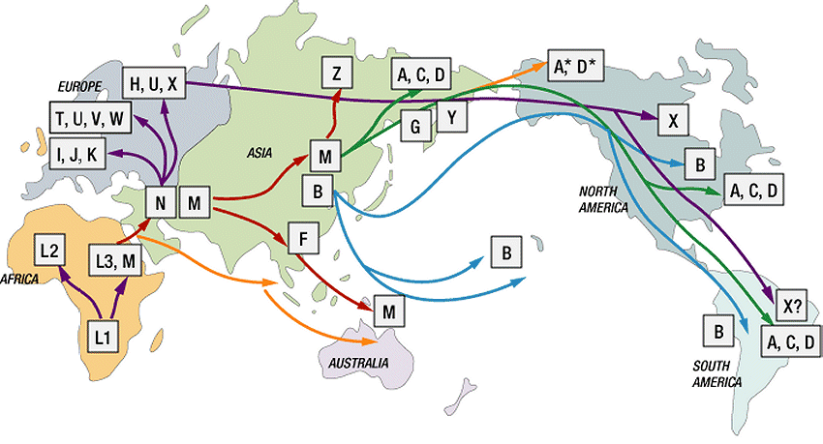
mt Haplogroups

Slide 19
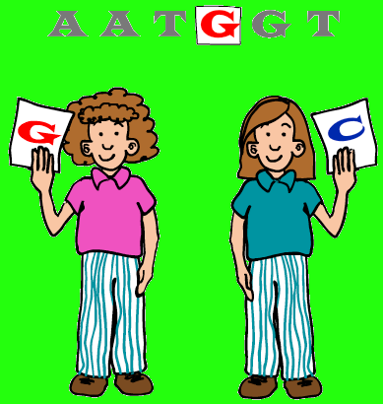

While these Haplogroups are great for tracing paternal or maternal lines, they apply only to the Y and mtDNA.
As we move along to the X and Autosomal Chromosomes, haplogroups play no role.
And drop out as well.
So, SNPs are the name of the game in Autosomes.

Slide 20
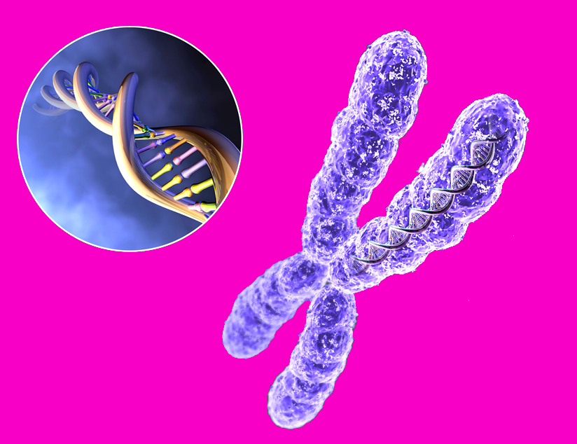
Y Chromosome
Mitochondrial DNA (mtDNA)
X Chromosome
Autosomal DNA

Slide 21
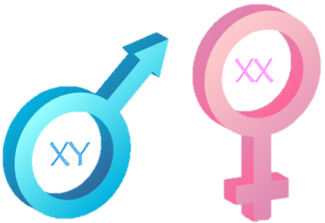
X Chromosomes
X chromosomes are a transition point for us as we move toward the Autosomes.
They are not Autosomes, of course, because they are Sex Chromosomes.
The X, just like the Y, contains STRs and SNPs.
The problem with studying the X is that it undergoes recombination during meiosis and, thereby, loses it’s fixed line of descent.
And it does this differently in Males than in Females.

Slide 22


Females have two X chromosomes while males have just one.
So, in females, the two X chromosomes randomly swap genes with each other along their entire length.

Slide 23

A female inherits one X chromosome from each of her two parents.
While the X chromosome from the female’s mother is a mixture of her parent’s DNA (i.e. the maternal grandparents’ DNA)….
…the X chromosome from her father is passed on, unchanged, from his mother and is a mixture of his mother’s parent’s DNA (i.e. the paternal great-grandparents’ DNA)

Slide 24

A male’s X chromosome is inherited from his mother and is a mixture of her two X chromosomes, one from her mother and one from her father.
It is therefore a mixture of the maternal grandparents’ X chromosomes.

Slide 25

Long Story Short….
The X Chromosome a female receives from her father is a generation behind in recombination.

Slide 26


Did you get all that?
X
Y
X
X
X
Y
X
X
X
Y
X
X
No!
X
Y

Slide 27
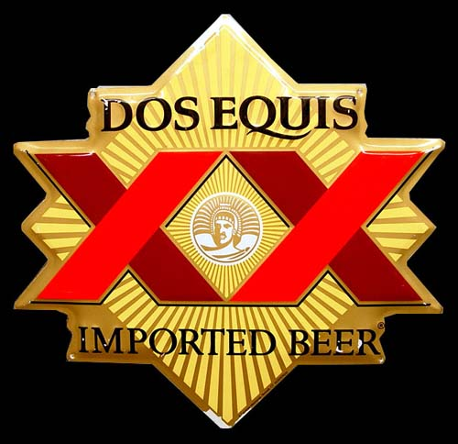

And now,
X
Y
X
X
X
Y
X
X
X
Y
X
X
X
Y
X
X
X
X

Slide 29

I hope that clears that up.

Slide 30
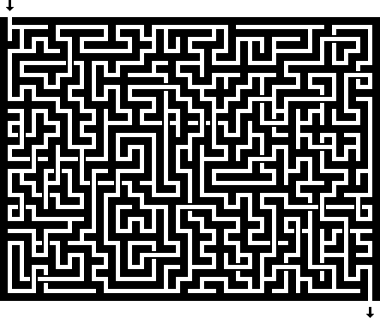
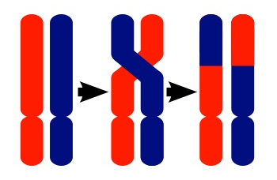

Anyway, keep in mind , the X recombines.
Up to now, we haven’t had to deal with that complication.

Slide 31

The Good News is….
You don’t have to deal with STRs and Haplogroups in Autosomal DNA studies.

Slide 32

Recombination.
~The Movie~

Slide 33

New
Territory

Slide 34

The Other
Y Chromosome
Mitochondrial DNA (mtDNA)
X Chromosome
Autosomal DNA
Chromosome
Pairs

Slide 35


Finally!
You can
Now Use
Your Entire
genetic

Slide 36

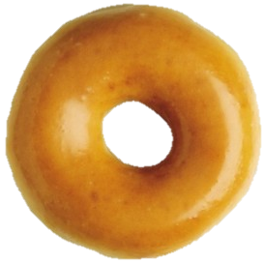
Autosomal DNA
And now, the good stuff.
Autosomal DNA is the 22 pairs of non-sex chromosomes found within the nucleus of every cell.
Autosomal DNA tests examine SNPs located throughout all of your DNA.

Slide 37

Your autosomes are composed of random combinations of your ancestors’ autosomes.
Autosomal DNA tests can be used to search for relative connections along any branch of your family tree….
… unless the connection is so far back that the shared DNA has essentially been eliminated through too many generations of recombination.

Slide 38
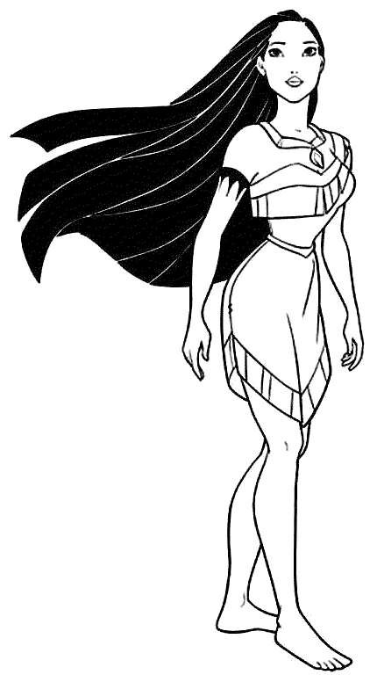
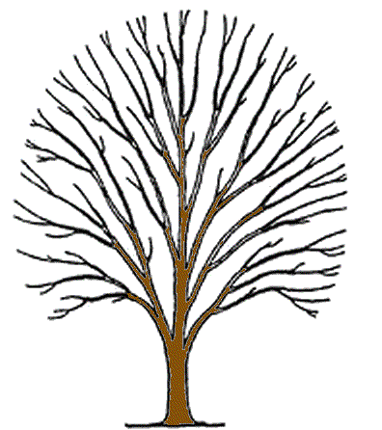
The Pocahontas Factor
Your autosomal test can tell you are kin to Pocahontas….
…but it can’t tell you on which branch of your family tree.

Slide 39
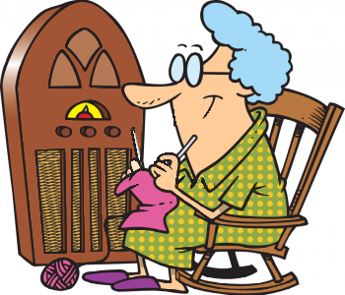

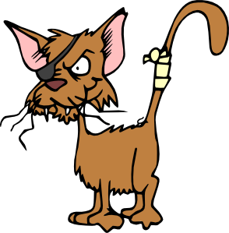
Use Grandma
Therefore, having your parents and/or grandparents tested as well will definitely help you to narrow down potential matches.
For instance, if you find a match to a particular segment and your grandmother also matches on that segment, it came from her line.

Slide 40
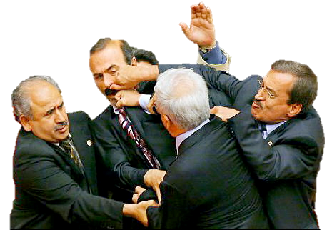

DNA Sample Collection Tip
When visiting an elderly person to request a sample, take several friends along.
In case they don’t want to give a sample.

Slide 41
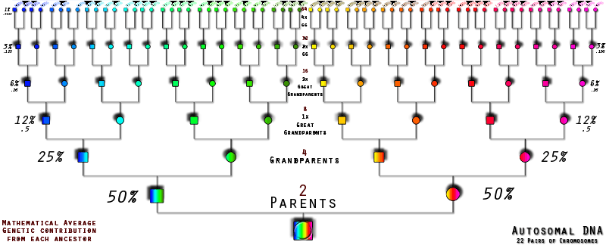
How we think our DNA comes down to us.
As you can see, our Autosomal DNA is
theoretically
representative of our whole ancestry.

Slide 42
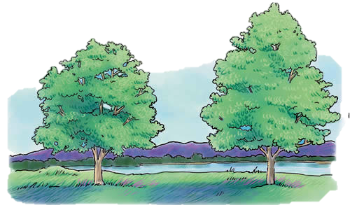
Umm, what do you mean by “theoretically?”
An important – and confusing – concept that people new to autosomal testing encounter is the fact that everyone has both a Genetic Tree and a Genealogical Tree.

Slide 43
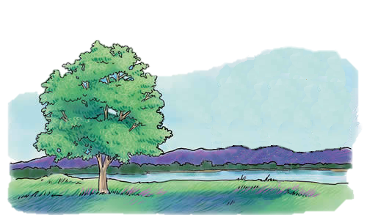
Umm, what do you mean by “theoretically?”
Your genealogical tree includes every one of your ancestors throughout history.
Your genetic tree, however, only includes those ancestors who were lucky enough to have their DNA pass through all of the recombinations down to you.

Slide 44
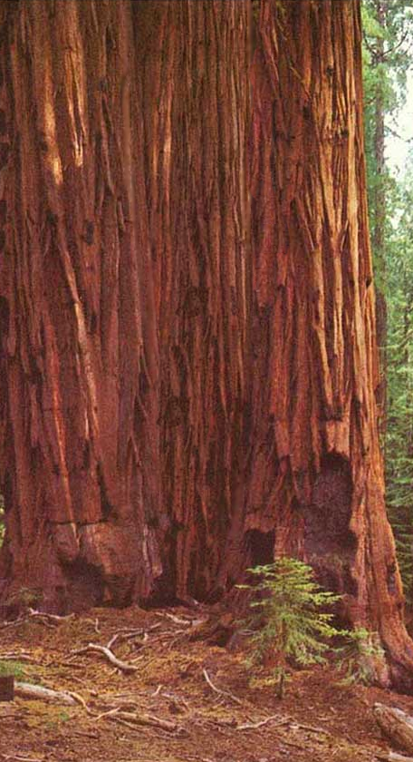
Genealogical
Tree
Actually, the difference in tree sizes is more significant than the previous picture of the two trees showed.
Genetic
Tree

Slide 45

Ancestors Fall Like Leaves
If it weren’t for recombination, we would only have 44 ancestors in our genetic tree….
…because we only have 22 pairs of autosomes of which there are 44 halves.
So the least each ancestor could have contributed would be one half of an autosome.

Slide 46
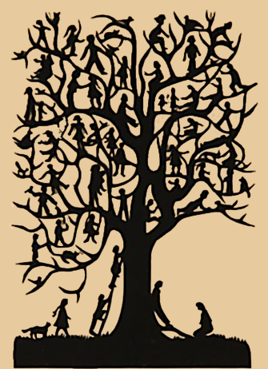

Recombination Saves the Day
But recombination mixes the
genes up.
The outcome is that we have
about 125 ancestors in our
genetic tree.

Slide 47
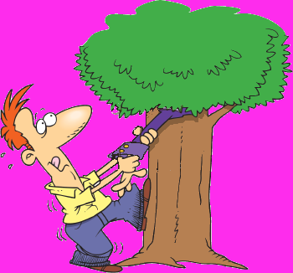
Recombination,
The Downside
But - because you end up with swapped alleles from both maternal and paternal grandparents in each recombined chromosome, you can’t use them (by themselves) to trace lineage.

Slide 48
Fading away.
Your parents are definitely in your genetic tree, as are your grandparents and great-grandparents.
Go back a few more generations, however, and your genealogical ancestors start dropping off your genetic tree.
Thus, your genetic tree is actually a tiny subset of your genealogical tree.
Further, while a genealogical tree remains constant (an ancestor will always be in a particular genealogical tree), a genetic tree changes with every new generation (that is, some ancestors will fall off the genetic tree with each new generation).

Slide 49


Fading away.
Only about 125 of our 1024 genealogical ancestors at 10 generations (or 11.7%) are our genetic ancestors.
The probability of having DNA from all of your genealogical ancestors at a particular generation becomes vanishingly small very rapidly.
You only have to go back 5 generations for genealogical relatives to start dropping off your genetic tree.

Slide 50
how many genetic ancestors we have after a certain number of generations

Slide 51

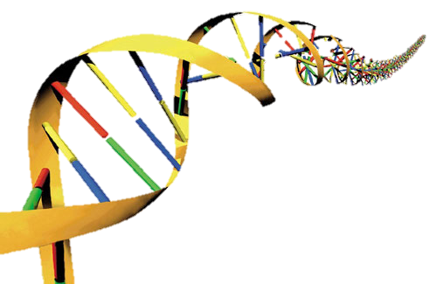
So how far back do you have to go before you begin to lose ancestral DNA big time?

Slide 53
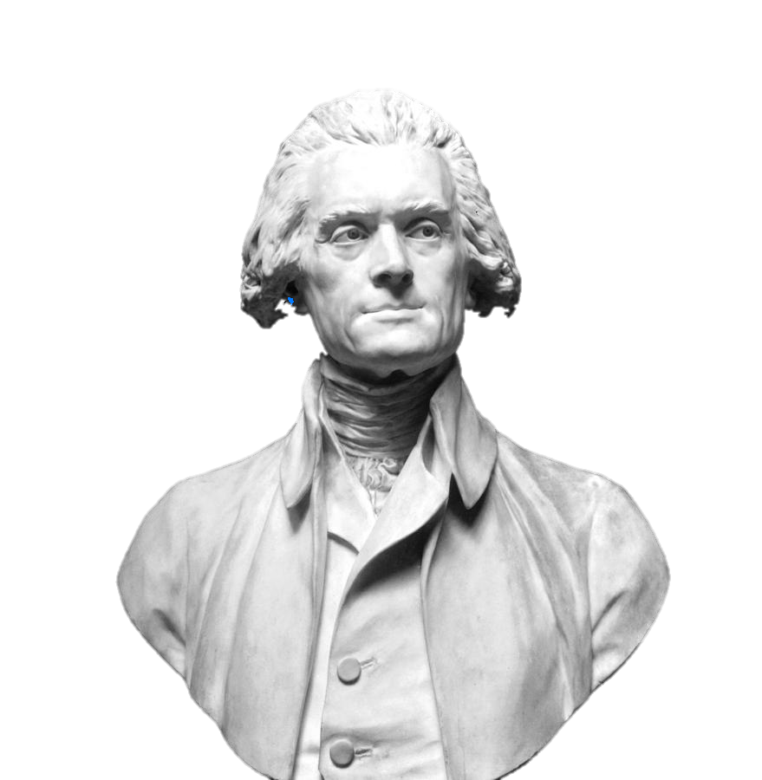
And what about that favorite or that famous ancestor like Pocahontas or Thomas Jefferson?
What’s the chance you still have any
of that ancestor’s DNA in your cells?

Slide 54
probability that you will have DNA of a specific ancestor from N generations ago

Slide 55








Slide 56

How do you get started doing your autosomal testing?

Slide 57
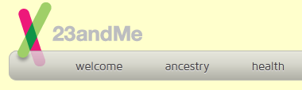
23andMe
The best deal at the moment seems to be at 23andme.com.
A test of all chromosomes, including mtDNA, is $99.

Slide 58
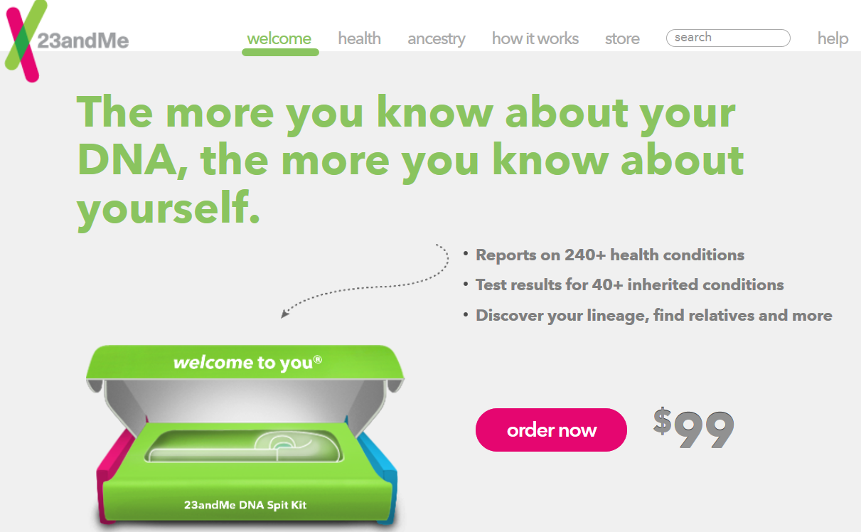
23andme.com

Slide 59
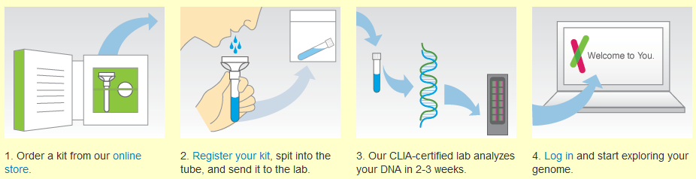
The Kit
Arrives in about a week.
You spit in a tube, close the top, and shake it for 20 seconds.
Put it in the pre-paid return mailer and send it off.

Slide 60

The Lab
The lab checks 1,000,000 markers or SNPs.
Then they send the data to 23andMe for posting.
This took about two weeks for my sample.

Slide 61

Your Profile
Once the data is loaded, you have the option of sharing all - or parts of it - or none of it.
This is handled in your Personal Profile which you set up while waiting for your Kit to arrive.

Slide 62
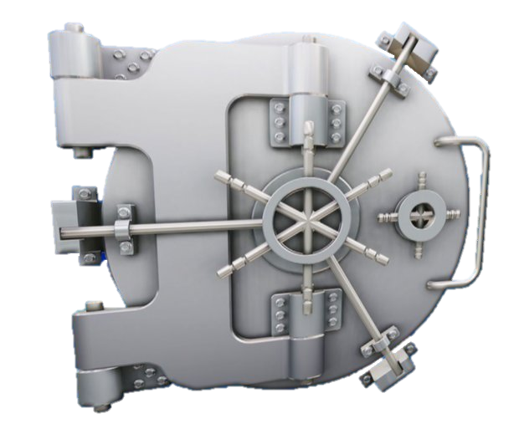
Your Profile
The default is NO SHARING with others.
And HEALTH data is, by default, NOT EVEN AVAILABLE TO YOU until you unlock it.

Slide 63


Health Data
Many people use 23andMe just for the health report.
You have to opt in to see your health data since it could be scary.
Then there is a further opt-in to see data on cancer, Altzheimers, and Parkinsons since that is even more scary.
Genealogists sometimes never look at their Health Report at all.

Slide 64
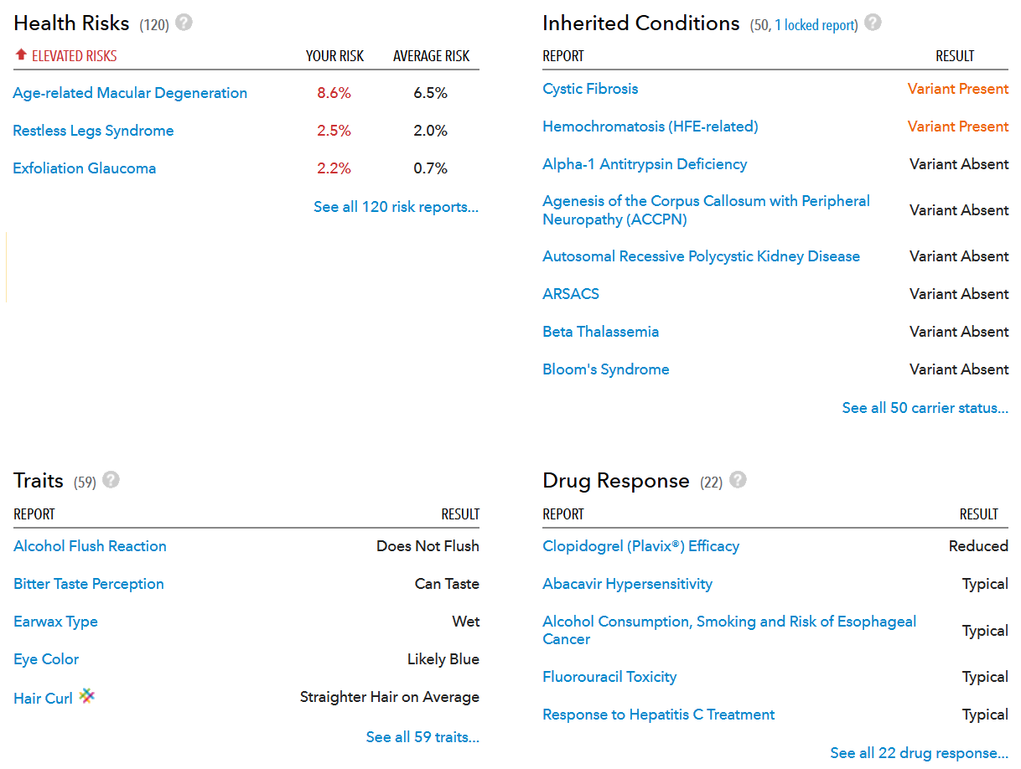

Slide 65


Yikes!
What if that data got out?
The Genetic Information Nondiscrimination Act, or GINA, has passed through Congress and was signed into law on May 21, 2008.
GINA protects Americans from discrimination on the basis of genetic information.
You believe that don’t you?
Well, don’t you?

Slide 66
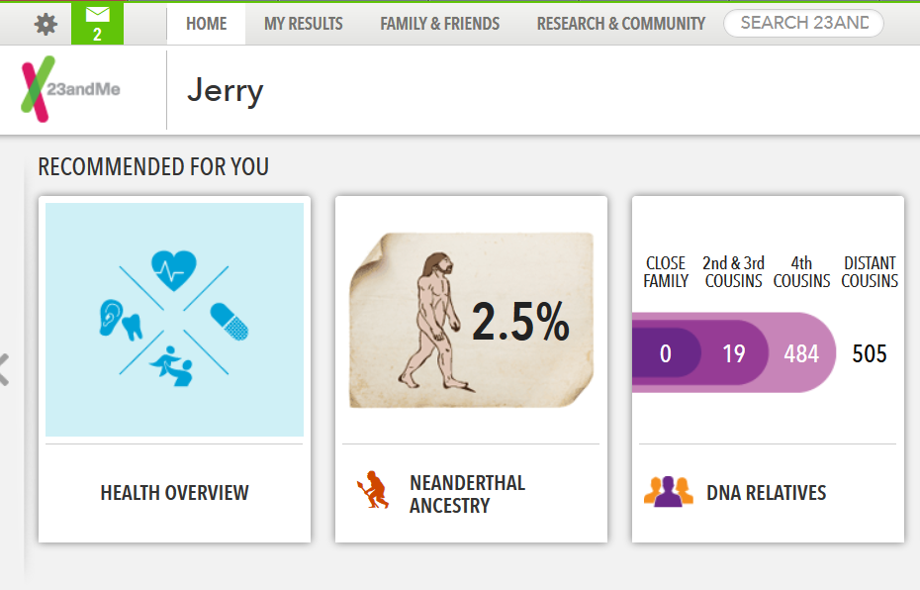

Slide 67
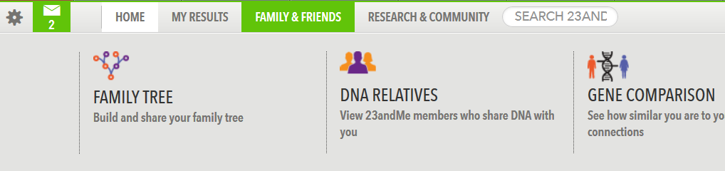

Slide 68
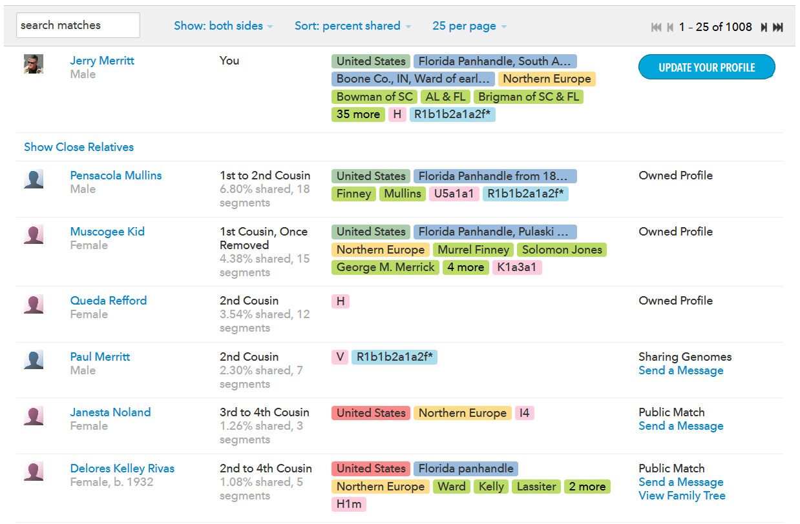

Slide 69
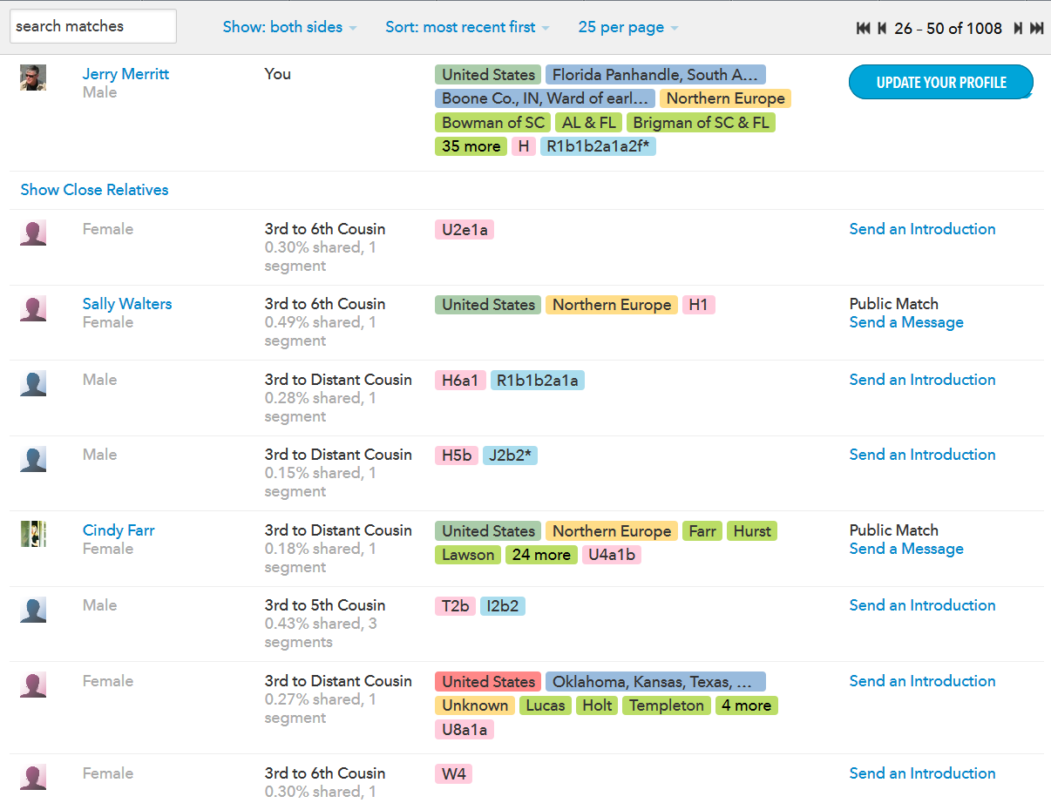
A More Representative Page

Slide 70
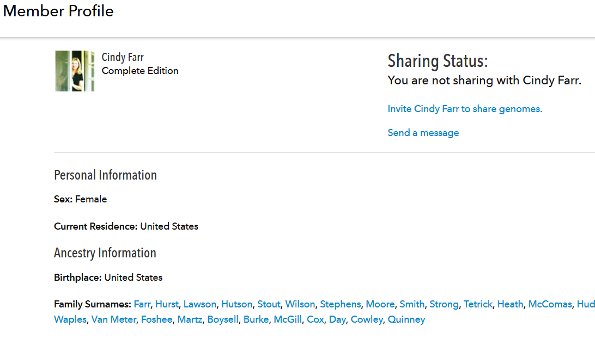
Sharing Genomes

Slide 71
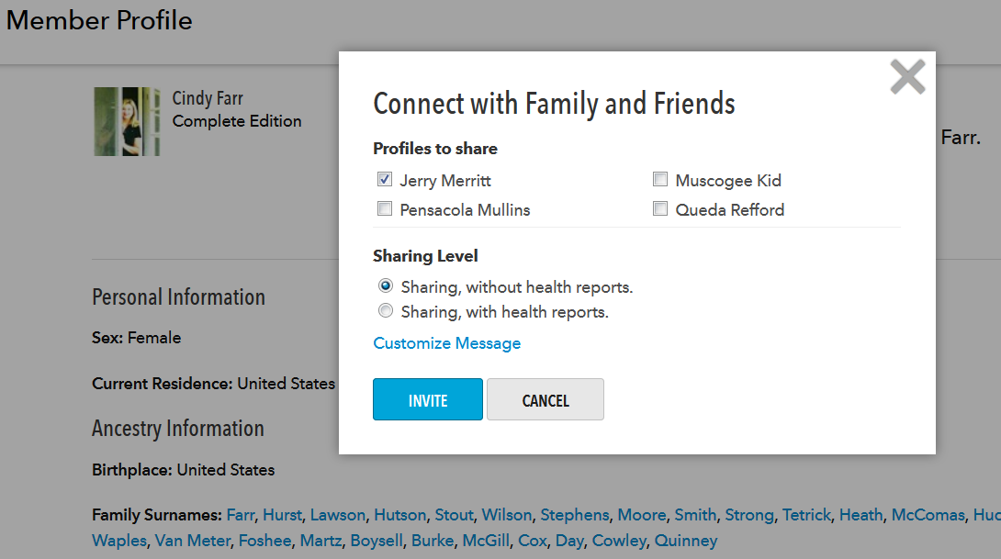
Sharing Genomes

Slide 73
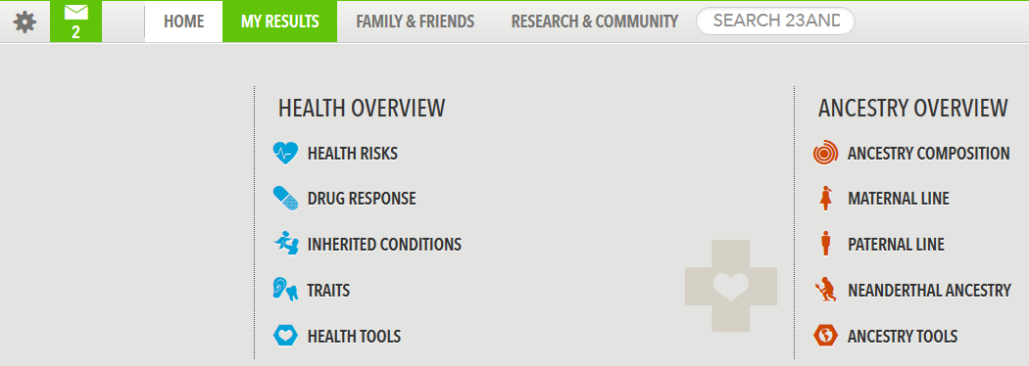

Slide 74
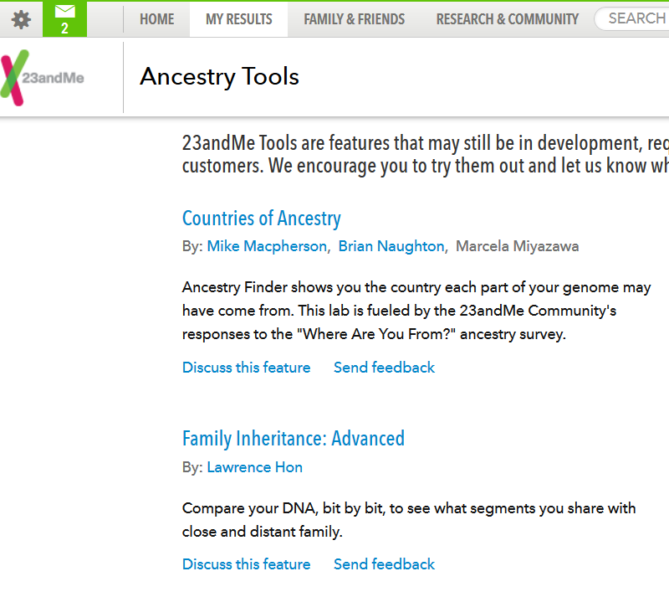

Slide 75
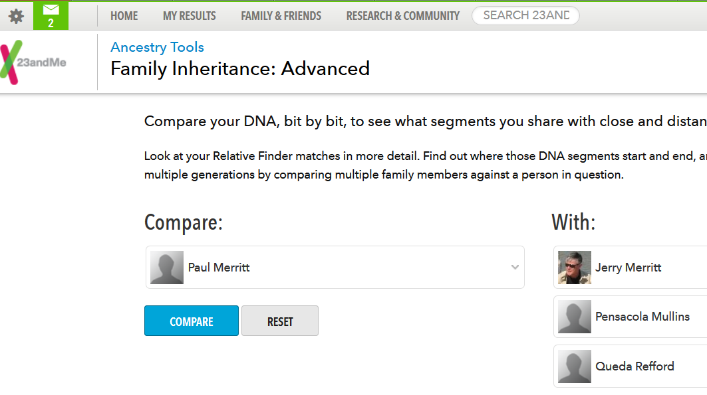

Slide 76


Slide 77


Slide 78
Inbox

Slide 79

Inbox

Slide 80

With Y and mtDNA testing the problem was too few contacts.

Slide 81



With Autosomal DNA testing the problem is too many.

Slide 82



Taming the Chaos

Slide 83
centiMorgan (cM)
equals a one percent chance that a marker on a chromosome will become separated from a second marker on the same chromosome by crossover in a single generation.
Different segments of a chromosome will have different tendencies to cross over.
So a short segment may be more likely to cross over than a longer segment in another location.

Slide 84
IBD vs. IBS
IBD: Inherited by Descent.
  A shared segment from a fairly recent common ancestor.
  Recent in a genealogical timeframe.
IBS: Inherited by State.
  A segment shared by happenstance.
  Not from a recent ancestor
5 cM is a reasonable threshold between the two.

Slide 85
Matching segments that are IBD vs. IBS (analysis by John Walden)

Slide 86


Slide 87


Slide 88

99.74%

Slide 89



Slide 90



Slide 91
Even with all of this capability, with the exception of the non-Indian connection, I have not been able to link to another relative by a specific line.
What might this mean for you?
What might make the investment in 23andMe useful to you?
Well, as in the Y and mtDNA, you need to have a problem that Autosomal DNA testing can solve.

Slide 92


Define the problem.
Typically you’re trying to connect to a missing link.

Slide 93

Go in with a plan.

Slide 94

For example.
After 18 years of detailed research….
…I didn’t know the father of a great-grandmother.
So I had no surname to try to connect to.
How then do I know if someone on my list of 23andMe relatives is my link to the missing father?

Slide 95

My plan
Identify some segments of DNA that I know come from the missing father.
Then if I connect to someone who has that same segment I’ll know they are also kin to the missing father.
So how do I go about doing that?

Slide 96

Putting the plan into action.
Figure out which connections I already have that are also descended from the missing father.
The great-grandmother in question had one sibling and I knew several of her great-grandkids.
Plus I knew several second cousins from my great-grandmother.
That gives me second and third cousins to work with but they have to take the DNA test with me.
Then any DNA segments we all share must be from the missing father or his wife….
Unless we are also kin along some other lines we don’t know about.

Slide 97
So how do I tell if the shared segments are from the missing father or, instead, from the mother – who I’m fairly sure of?
I have to locate someone descended from the mother’s line but not the father’s line. That requires another third or fourth cousin or two.
If those cousins also share one of the segments it means it came from the mother’s line.
If they don’t share it, then it probably came from the missing father.

Slide 99


Third Cousins

Slide 100



So I now have segments on chromosomes 4 and 8 that are probably from the parents of the two great-grandmother sisters.

Slide 101


Slide 105
Or you can download your entire genome
# rsid chromosome position genotype
rs4477212 1 72017 AA
rs3094315 1 742429 AA
rs3131972 1 742584 GG
rs12124819 1 766409 AG
rs11240777 1 788822 GG
rs6681049 1 789870 CC
rs4970383 1 828418 AA
rs4475691 1 836671 TT
rs7537756 1 844113 AG
rs13302982 1 851671 AG
rs1110052 1 863421 GG
rs2272756 1 871896 AG
rs3748597 1 878522 CC
rs13303106 1 881808 AA
rs28415373 1 883844 CC
rs13303010 1 884436 AG
rs6696281 1 892967 TT

Slide 106
Even Y and mtDNA
# rsid chromosome position genotype
rs28698289 Y 57437890 G
rs2334088 Y 57438752 A
rs6568298 Y 57439116 T
rs4047343 Y 57440310 G
rs6568295 Y 57440901 G
rs2334083 Y 57441719 C
rs9724556 Y 57442197 C
i4001200 MT 3 T
i4001110 MT 7 A
i4001358 MT 9 G
i4000553 MT 26 C
i4001079 MT 40 T
i4001190 MT 41 C
i4000964 MT 43 C
i4001177 MT 46 T
i4000987 MT 49 A

Slide 107
STR ≠ SNP
But don’t forget, you can’t compare your Y and mtDNA markers using STRs to the markers using SNPs.
Those are two entirely different marker systems.
And there’s no way to convert one to the other.

Slide 108

Downoading Your Genome

Slide 109

Downoading Your Genome

Slide 110

Downoading Your Genome

Slide 111
You’ve got your genome on your computer.
Now what?
Upload it to gedmatch.com
That will let you match against others not in 23AndMe.
It will also provide you with a wealth of data not available at 23AndMe.
You can also upload your GEDCOM to GEDMatch to help others see where they connected to your lines.

Slide 112


GEDMatch.com

Slide 113


Slide 114



Slide 115

One-to-many DNA comparison

Slide 116



Slide 117
Should You Do Autosomal Testing?
If you have living parents or aunts and uncles.
If you have a dead end back not more than 5 or 6 generations.
If you’re adopted and want to find your birth parents.
If you want to get a health report based on your DNA.
If you just want to play endlessly contacting others who share DNA with you.

Slide 118



Slide 119
Does the DNA Test Do the Hard Work?
Why, no.
No it doesn’t.
It does the easy work….
And leaves the hard
work for you.

Slide 120
The Full 30 meg PowerPoint is Here:
pensacolalinks.com/autosome.ppt

